Slide 1

Serverless Computing: Evolution and Challenges
Digital technologies have revolutionized business models, with cloud computing offering scalable infrastructure. AWS introduced serverless computing in 2014 with Lambda, marking a paradigm shift in application development and deployment strategies.

Slide 2
The Rise of Serverless Computing
Infrastructure Abstraction
Popular Platforms
Key Benefits
Serverless computing eliminates infrastructure management, allowing developers to focus solely on code. This paradigm shift simplifies development processes and reduces operational overhead.
Major cloud providers offer serverless solutions: AWS Lambda, Google Cloud Functions, and Azure Functions. These platforms enable rapid deployment and automatic scaling of applications.
Serverless architecture improves scalability for event-driven applications and microservices. It offers cost-efficiency through pay-per-execution models and reduces time-to-market for new features.

Slide 3

Understanding the Cold Start Problem
1
Initial Request
A function is invoked after a period of inactivity, triggering a cold start.
2
Resource Allocation
The serverless platform allocates necessary resources, including container initialization and code loading.
3
Execution Delay
The function experiences a delay before execution, impacting overall response time.
4
User Impact
Latency-sensitive applications suffer from degraded user experience due to cold starts.

Slide 4

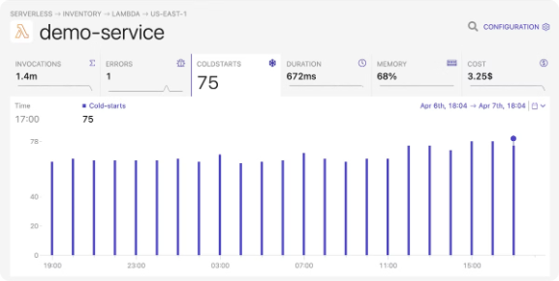
Motivation for Addressing Cold Starts
1
Latency Concerns
2
Inefficient Solutions
3
Performance Optimization
Cold starts can introduce delays ranging from milliseconds to seconds. This variability poses challenges for real-time applications in IoT and finance sectors.
Existing approaches like container pre-warming are often costly and inefficient. They may lead to unnecessary resource consumption and increased operational expenses.
There's a critical need for adaptive solutions that balance resource utilization and performance. Optimizing cold starts can significantly enhance overall application responsiveness.

Slide 5





Objectives of the Cold Start Optimization Study
Develop ML Framework
Enhance Transparency
Optimize Idle Containers
Reduce Latency
Create a machine learning-based adaptive framework incorporating Explainable AI (XAI) techniques.
Improve visibility into serverless resource management decisions for better debugging and optimization.
Develop algorithms to determine optimal idle container duration, balancing cost and performance.
Implement strategies to minimize cold start latency and improve overall application performance.

Slide 6


Expected Contributions to Serverless Computing
AI-Driven Enhancements
Cost-Effective Solutions
Provide insights on leveraging AI for serverless performance optimization. Demonstrate the potential of machine learning in addressing complex infrastructure challenges.
Develop transparent, adaptive mechanisms for high-demand environments. Optimize resource allocation to reduce operational costs without compromising performance.
Real-Time Application Boost
Industry Impact
Transform serverless computing for latency-sensitive applications. Enable new use cases in IoT, finance, and other real-time data processing domains.
Influence best practices in serverless architecture design. Provide a foundation for future research in cloud computing optimization techniques.

Slide 7

Methodology and Implementation Approach
Phase
Description
Outcome
Data Collection
Gather serverless function metrics and performance data
Comprehensive dataset for analysis
Model Development
Design and train ML models for cold start prediction
Accurate predictive models
XAI Integration
Implement explainable AI techniques for transparency
Interpretable decision-making process
Optimization Algorithm
Develop adaptive resource management algorithms
Efficient container lifecycle management
Evaluation
Conduct experiments and benchmark against existing solutions
Performance metrics and insights

Slide 8





Future Implications and Research Directions
Edge Computing Integration
Advanced AI Techniques
Explore synergies between serverless and edge computing for ultra-low latency applications.
Investigate reinforcement learning and federated learning for distributed serverless optimization.
Security Enhancements
Cross-Platform Optimization
Develop AI-driven security measures to protect serverless functions from emerging threats.
Create unified frameworks for optimizing serverless performance across multiple cloud providers.

Slide 9


Cloud Computing Models Overview
Cloud computing offers various service and deployment models, each catering to different organizational needs. These models provide flexibility in resource management, scalability, and control over infrastructure.
Understanding these models is crucial for optimizing cloud strategies and leveraging the full potential of cloud technologies.

Slide 10
Serverless Computing and Cold Start Challenges
Serverless Computing
Cold Start Problem
Mitigation Strategies
Serverless computing, or Function-as-a-Service (FaaS), runs applications as stateless functions. It's event-driven and auto-scaled, with providers managing the infrastructure.
Cold starts occur when initializing containers after inactivity. This delay impacts latency-sensitive applications like IoT and real-time data processing.
Keeping functions in a "warm state" mitigates cold starts. However, this approach may lead to resource waste and increased costs.

Slide 11

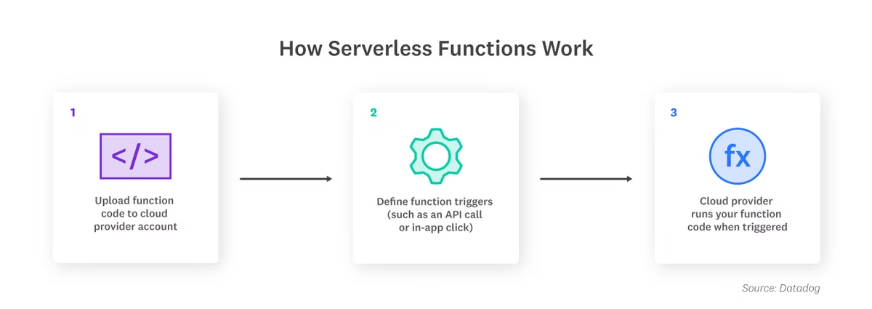
Cold Start Mitigation Techniques
1
Container Pooling
Reuse halted containers for quick access. This reduces initialization time and improves overall performance.
2
Pre-Warming
Keep containers warm post-execution to reduce delays. AWS provisioned concurrency implements this strategy effectively.
3
Prebaking & Warm Template Queue
Pre-create environment snapshots and maintain warm containers in queues. This enables rapid execution on demand.
4
Dynamic Prediction
Use ML to predict demand based on historical data. This optimizes container readiness and minimizes latency.

Slide 12


Cold Start Mitigation in Serverless Computing
Cold start latency poses a significant challenge in serverless environments. This presentation explores traditional and advanced techniques for mitigating cold starts, enhancing performance and resource utilization in cloud functions.

Slide 13




Traditional Cold Start Mitigation Techniques
Container Pooling
Pre-Warming
Prebaking
Warm Template Queue
Pre-warmed containers are maintained in a pool, ready for instant reuse. AWS Lambda, Google Cloud, and Azure employ this technique for faster initialization.
Containers remain warm post-execution, reducing delays. AWS's provisioned concurrency exemplifies this approach, balancing performance with resource usage.
Container state snapshots are saved, accelerating future starts. This is particularly effective for functions with extensive dependencies.
A queue of warm containers stands ready for instant use, significantly lowering latency when functions are triggered.

Slide 14


Machine Learning-Based Cold Start Mitigation
Machine learning offers advanced cold start mitigation by predicting invocation patterns and dynamically adapting resources. This includes techniques such as:
LSTM Models: Predict invocation patterns based on historical data, pre-warming containers before demand spikes.
Reinforcement Learning: Adapt to fluctuating demands in real-time, optimizing instance scaling using dynamic feedback.
Advanced Techniques: Utilize hybrid histogram policies and deep reinforcement learning to constantly optimize container strategies for dynamic workloads and evolving cloud environments.

Slide 15

Adaptive Framework for Cold Start Mitigation
Our proposed framework tackles cold start issues in serverless computing. It uses a two-layer approach, combining machine learning predictions with dynamic resource management. This innovative solution minimizes both cold start frequency and delay, optimizing performance and cost-efficiency.

Slide 16

Layer 1: Reducing Cold Start Frequency
1
Invocation Pattern Extraction
Analyzes historical function usage to identify potential cold start periods. This step forms the foundation for predictive modeling.
2
Deep Neural Network Prediction
Utilizes advanced neural networks to predict optimal idle-container windows. Balances response times with resource efficiency for optimal performance.
3
Error Minimization and Dynamic Updates
Implements an error function to balance cold starts against resource usage. Continuously adjusts the idle-container window based on real-time predictions.

Slide 17




Layer 2: Reducing Cold Start Delay
Concurrent Invocation Prediction
Employs LSTM models to anticipate demand spikes. This advanced forecasting prepares resources proactively for optimal performance.
Pre-warmed Container Allocation
Allocates containers based on predicted demand. This strategy significantly reduces cold start delays during peak usage times.
Dynamic Resource Allocation
Adjusts resources in real-time for maximum efficiency. Ensures optimal responsiveness to fluctuating demand patterns.

Slide 18

Model Formulation & Optimization
Reward Function
Parameter Updates
Implements a sophisticated reward function to minimize cold starts. Uses a penalty factor for memory inefficiency, balancing performance and cost.
Continuously refines configurations based on real-time data. Ensures optimal performance and responsiveness in dynamic serverless environments.
Machine Learning Integration
Leverages advanced ML algorithms for intelligent decision-making. Adapts to changing patterns and optimizes resource allocation over time.

Slide 19




Key Takeaways
Enhanced Performance
Significantly reduces cold start frequency and delay. Improves overall user experience and application responsiveness.
Intelligent Adaptability
Utilizes machine learning for smart, adaptive resource management. Continuously optimizes based on real-time data and changing patterns.
Improved Reliability
Ensures consistent performance during demand fluctuations. Optimizes cost and resource usage while maintaining high availability.

Slide 20

Evaluating Adaptive Models in Serverless Computing
Assessing impact on cold start latency across platforms.

Slide 21

Experimental Design
1
Platforms
AWS Lambda, Azure Functions, Apache OpenWhisk deployed.
2
Setup
Standardized memory, timeout, concurrency limits across platforms.
3
Applications
Email, image, data, video processing tasks tested.

Slide 22




Performance Metrics
Response Time
Function completion speed, lower is better.
Cold-Start Delay
Time difference between cold and warm starts.
Cold Start Frequency
Occurrence count, lower means better efficiency.

Slide 23




Results and Analysis
Response Time
Cold-Start Delay
Cold-Start Frequency
30% reduction, improved system responsiveness.
40% decrease, optimized latency-sensitive tasks.
50% reduction, smoother operation and cost savings.

Slide 24

Discussion and Implications
Dynamic Resource Management
Efficiency and Cost-Effectiveness
Predicts usage, adjusts container readiness, minimizes delays.
Reduces unnecessary warm-up, optimizes serverless environment costs.
Enhanced User Experience
Faster responses, lower latency, smoother user interactions.

Slide 25

Adaptive ML Model for Serverless Cold Start Latency
This presentation outlines an innovative approach to mitigate cold start latency in serverless environments. We developed an adaptive machine learning model to optimize function initialization and enhance overall system performance.

Slide 26

Objective and Approach
1
Primary Goal
2
Machine Learning Integration
Develop an adaptive model to address cold start latency in serverless computing environments.
Leverage ML algorithms to predict and optimize function initialization patterns.
3
Adaptive Methodology
Implement a self-adjusting system responsive to changing workload patterns and platform conditions.

Slide 27
Key Components of the Adaptive Model
Data Collection
Prediction Engine
Feedback Loop
Gather historical invocation data, execution times, and resource utilization metrics.
Employ ML algorithms to forecast function warm-up needs and resource allocation.
Continuously update the model based on real-time performance data and outcomes.

Slide 28
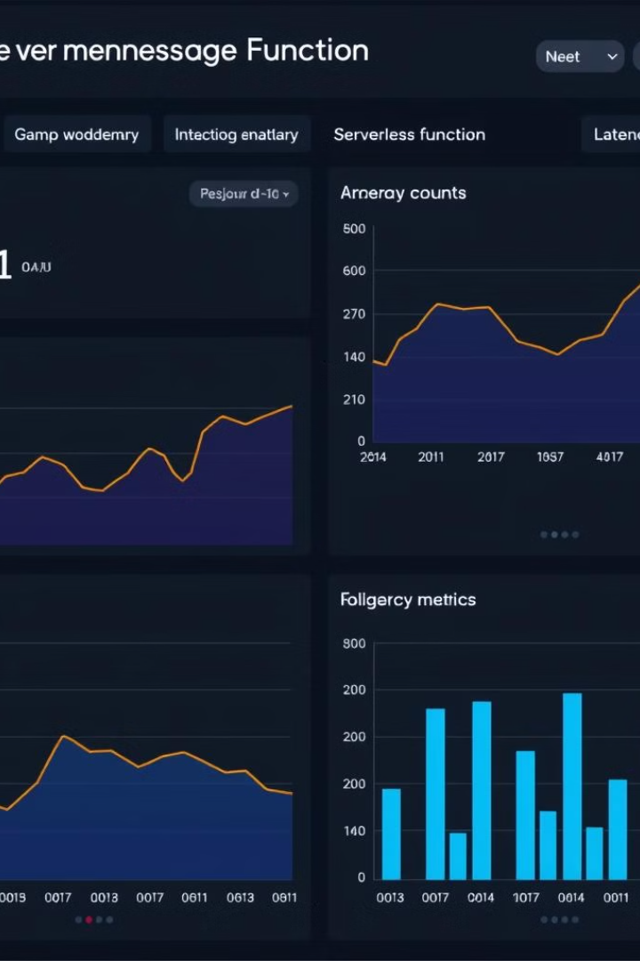
Performance Metrics and Evaluation
Metric
Before Optimization
After Optimization
Average Cold Start Time
2.5 seconds
0.8 seconds
Resource Utilization
65%
82%
Cost Efficiency
Baseline
22% improvement

Slide 29

Future Enhancements
Advanced ML Algorithms
Edge Computing Integration
Multi-Cloud Optimization
Incorporate deep learning and reinforcement learning for more accurate predictions.
Extend the model to optimize serverless functions at the network edge.
Develop a unified model for seamless performance across diverse cloud platforms.

Slide 30

Conclusion and Impact
Performance Boost
Cost Optimization
Significant reduction in cold start latency, enhancing overall serverless application responsiveness.
Improved resource utilization leading to reduced cloud infrastructure costs for organizations.
Scalability
Industry Impact
Adaptive model scales efficiently to handle varying workloads and serverless platform changes.
Potential to revolutionize serverless computing, making it more viable for latency-sensitive applications.

